Slide 1
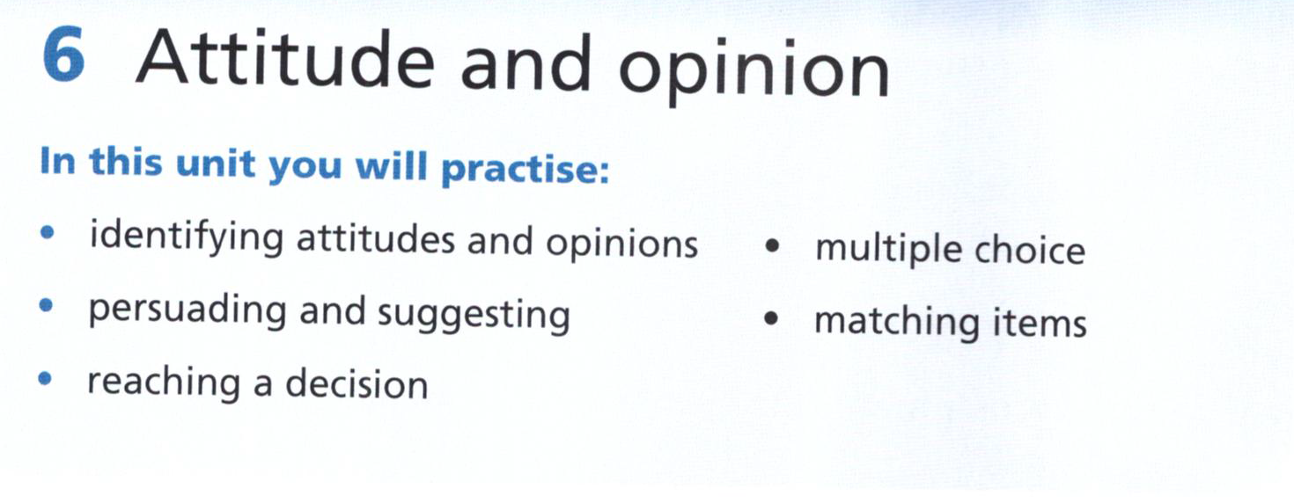

Slide 2
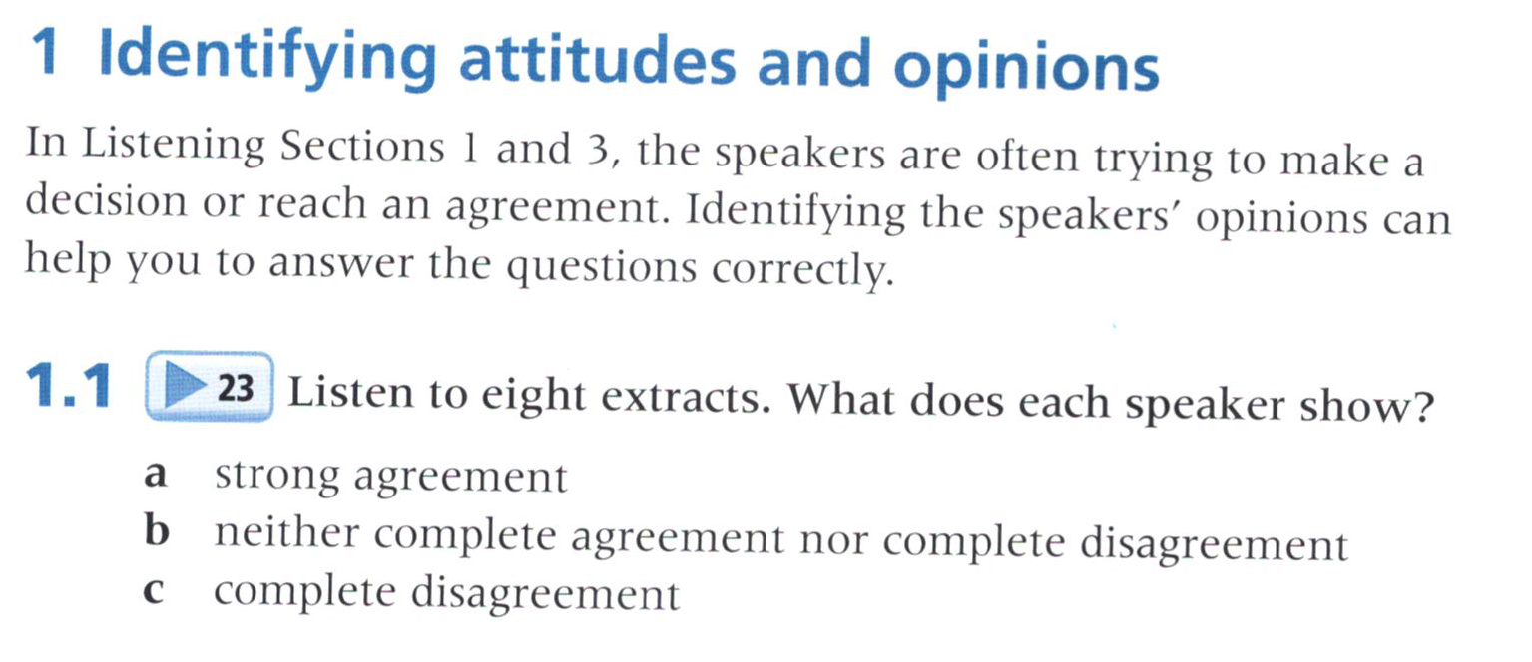
23

Slide 3
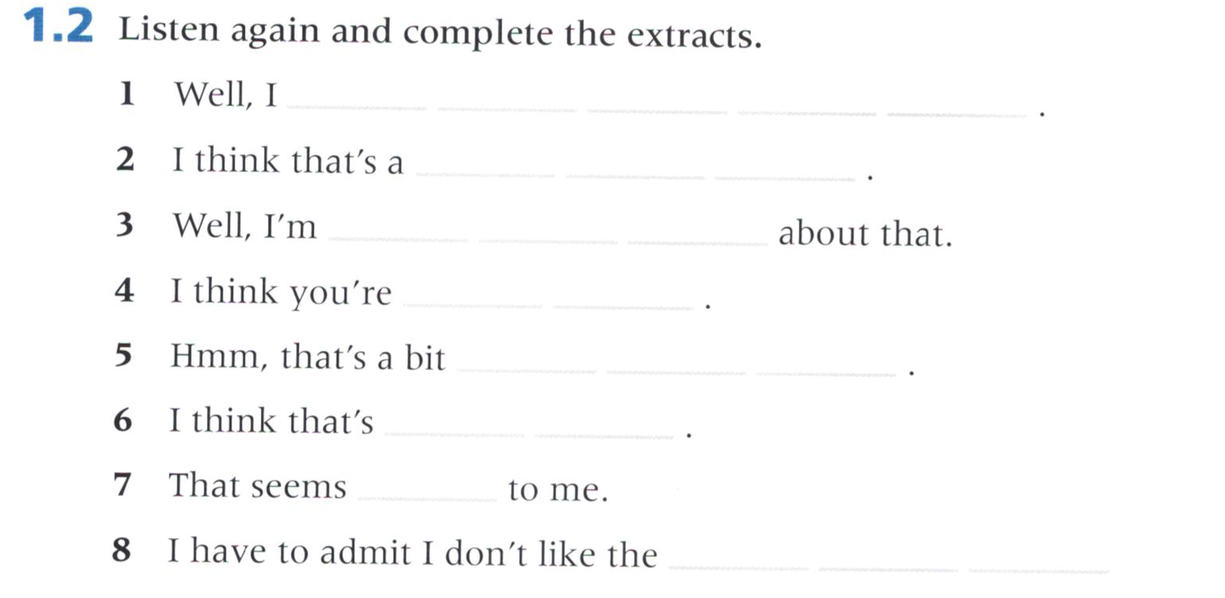
23
b. neither
agree up to a point
a. agree
really valid point
b. neither
not so sure
a. agree
absolutely right
b. neither
hard to believe
c. disagree
highly unlikely
b. neither
doubtful
c. disagree
sound of that at all

Slide 4
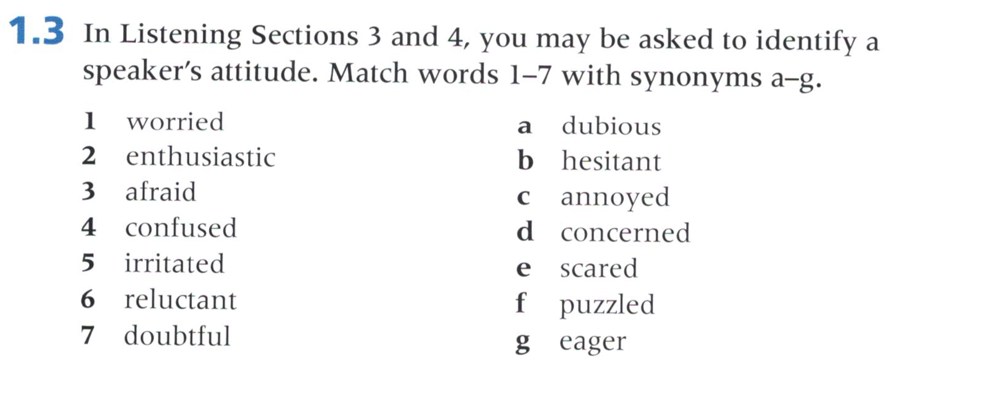

Slide 5
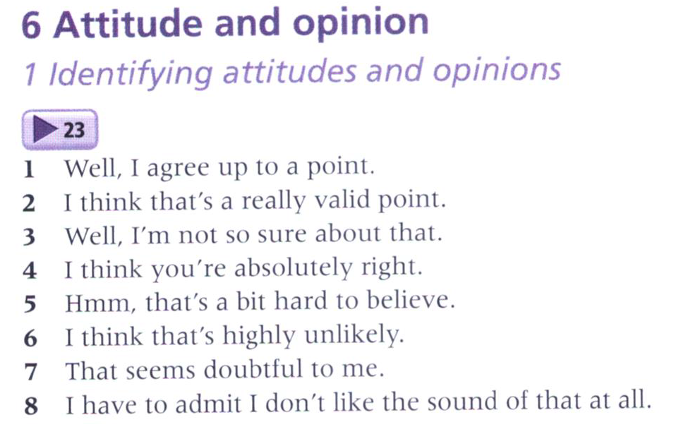

Slide 6
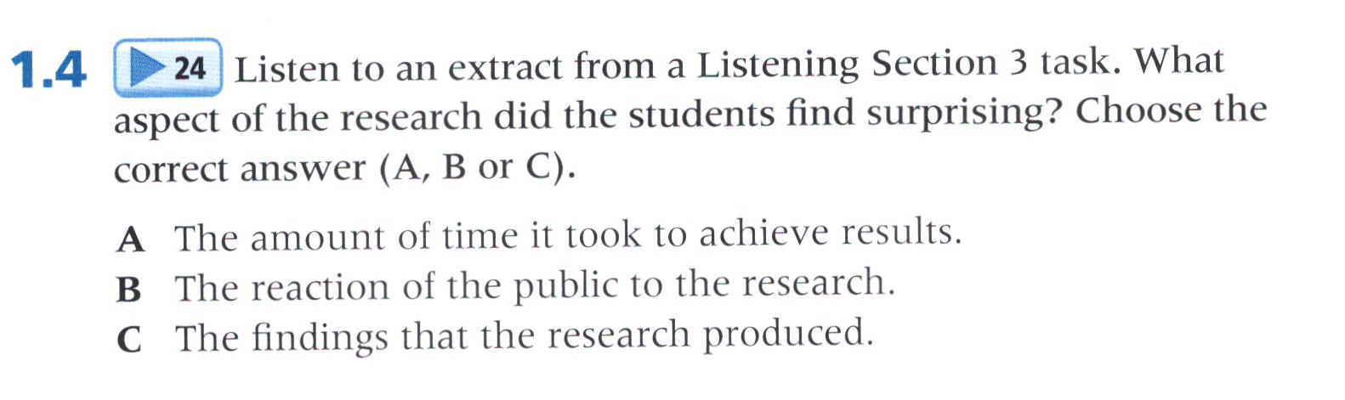
24

Slide 7
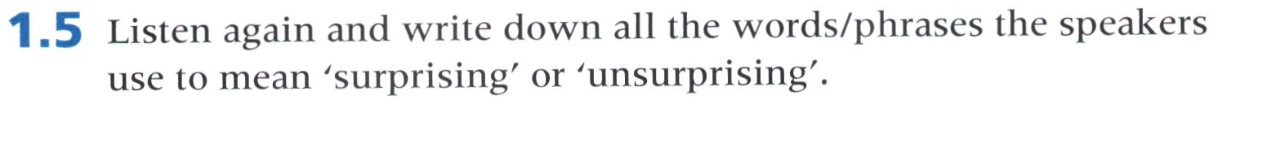
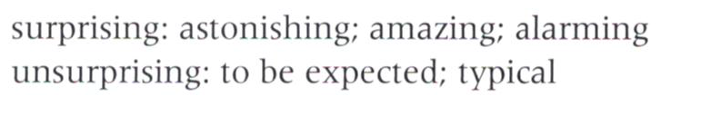
24
Listen for information about the research
Well thought out
3 yrs to produce result
Expected given age
Chart progress
Astonishing results
Watching TV, kids’ obesity

Slide 8
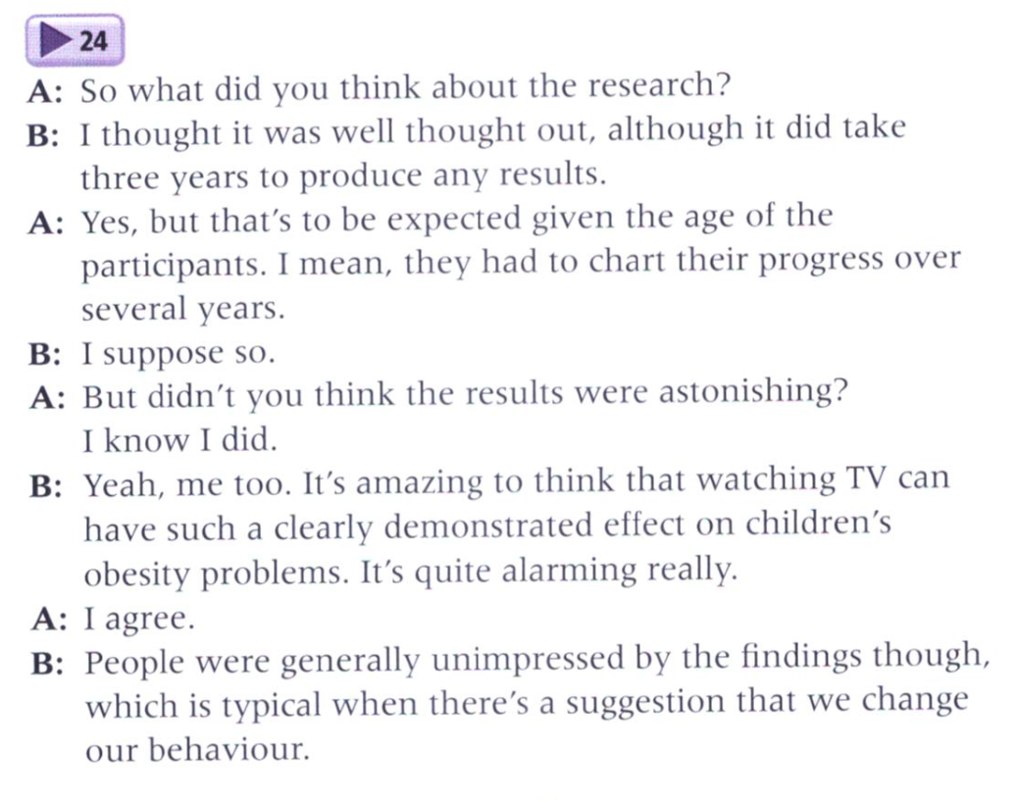
24

Slide 9
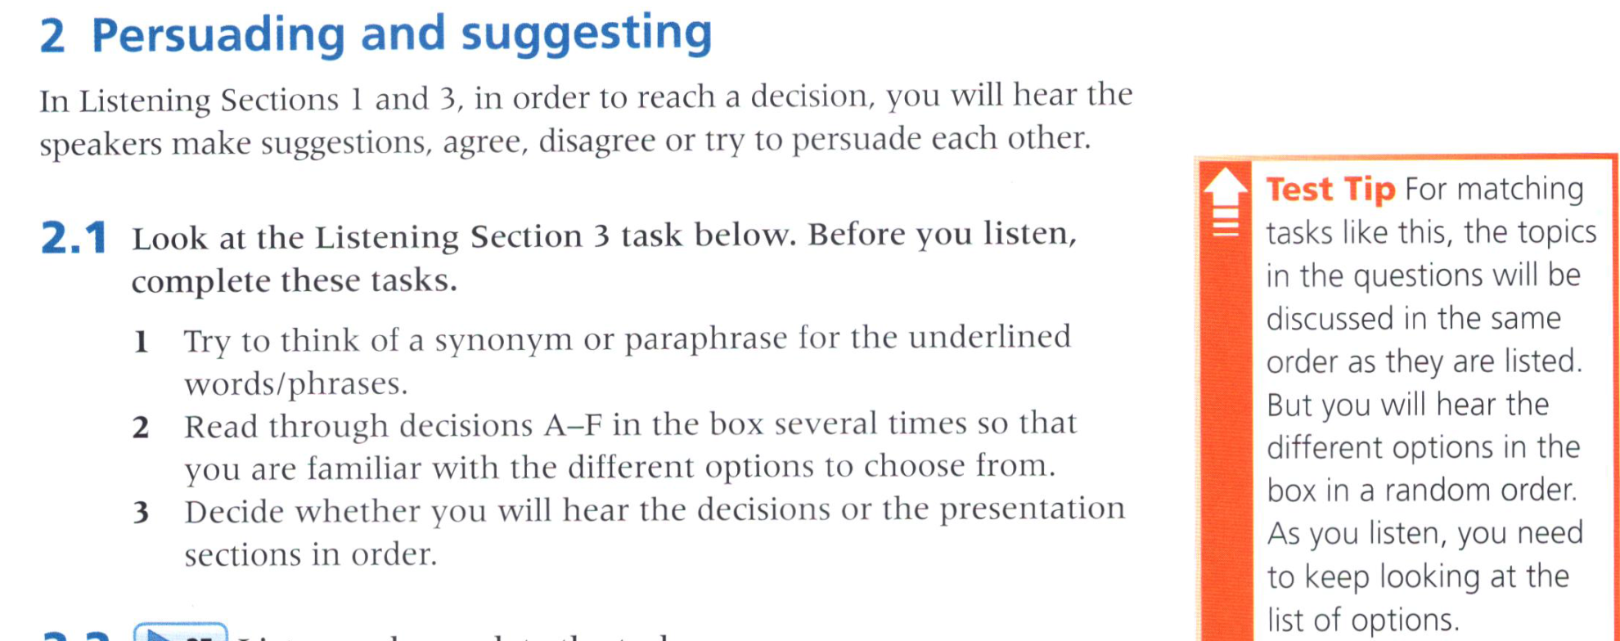

Slide 10
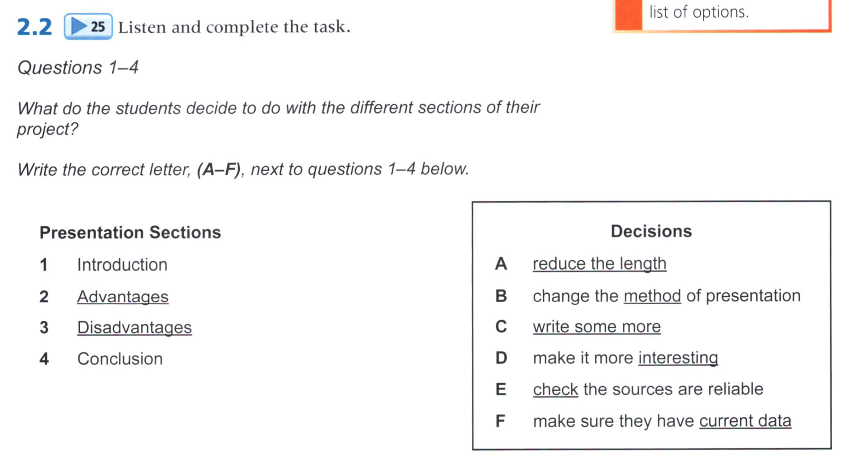
25
D
A
B
F
Take notes by following the order of presentation.

Slide 11
presentation
long, only 10 mins
introduction
not exciting, but no cutting, yes
Bring actual equipment, great, grab attention
benefits: plenty
leave out sth obvious? Yes
save time
negative: different
like hearing sth wrong
quotes about problems
read them but now video, better, variety of media, get higher mark
conclusion
include more, now short, yes
But not much to say

Slide 12
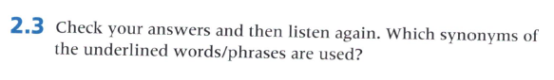
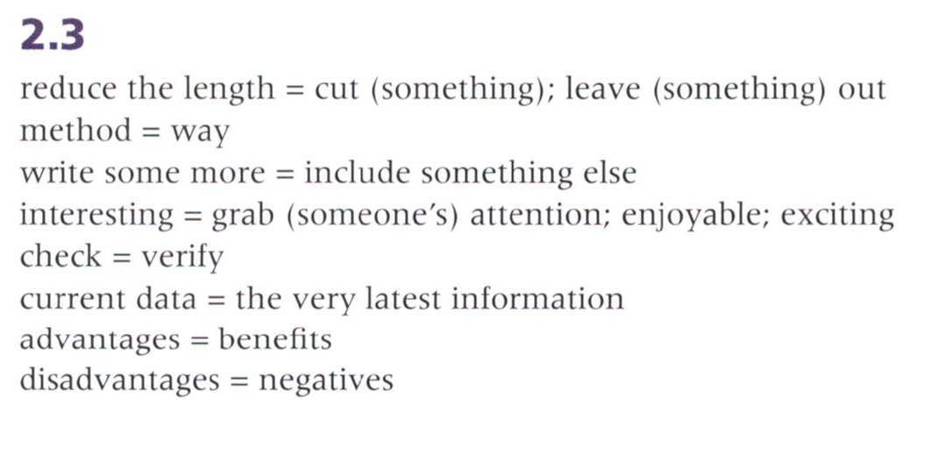
25

Slide 13
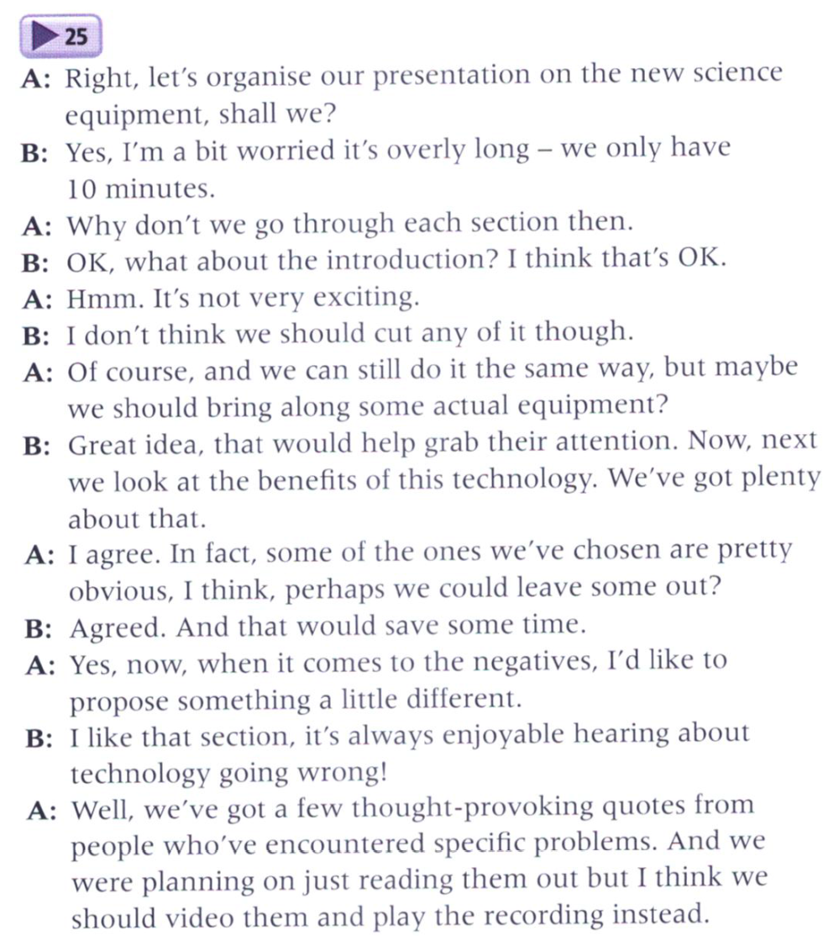
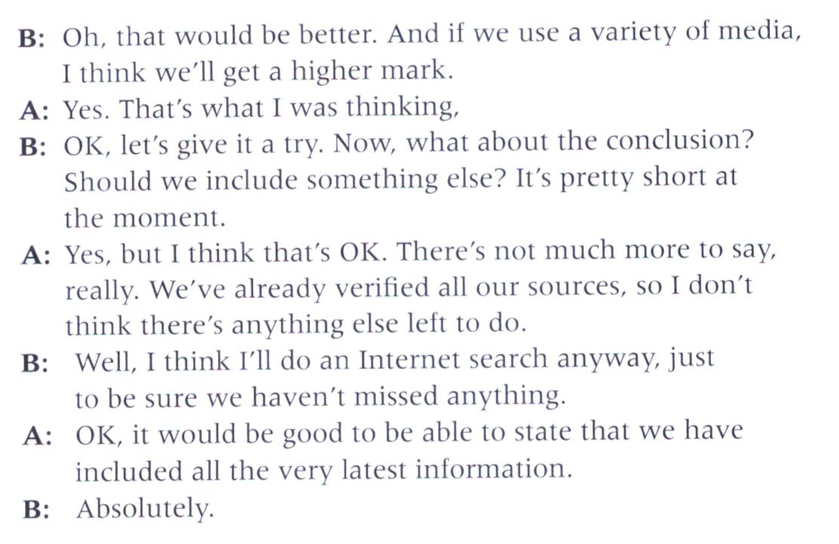
25

Slide 14
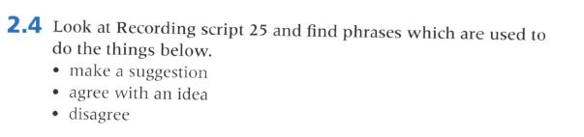
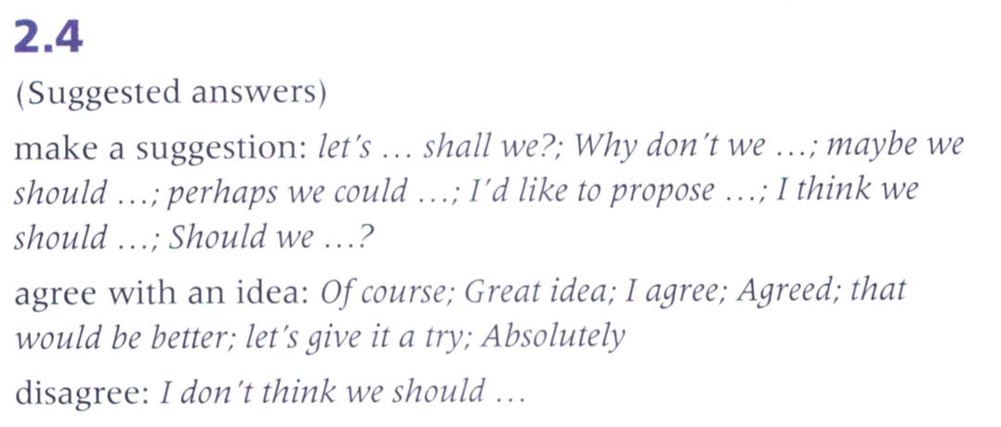

Slide 15
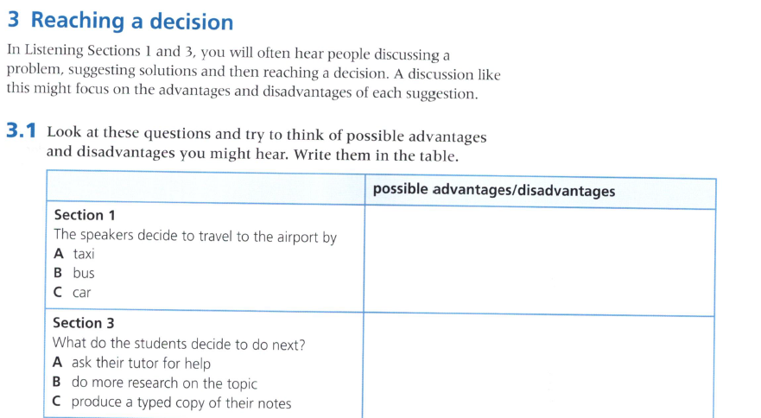
26
distance, cost, convenience, availability
to get help, to find out more, to make it presentable
3.2 Listen and answer the questions in 3.1

Slide 16
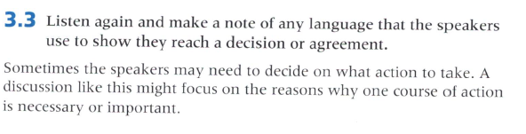
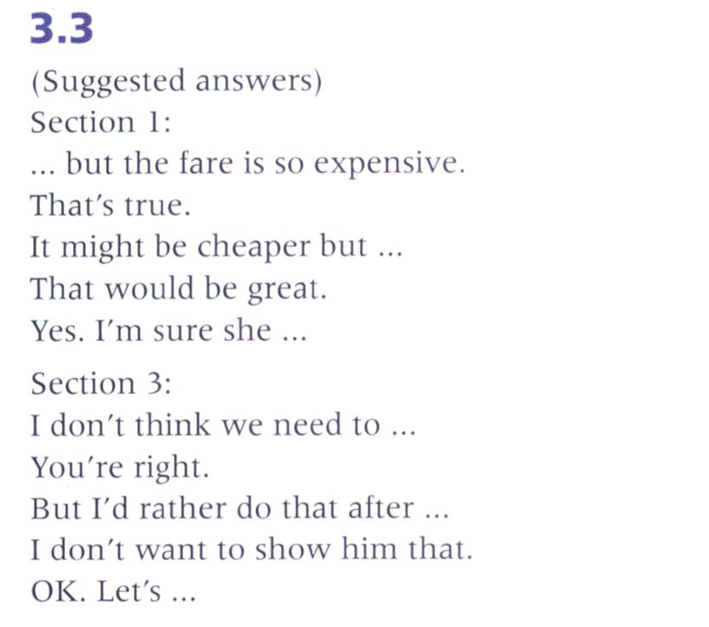
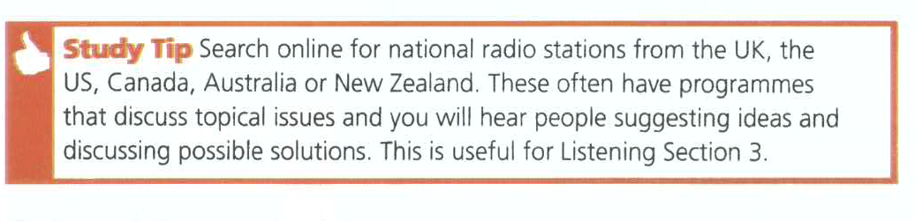
26

Slide 17
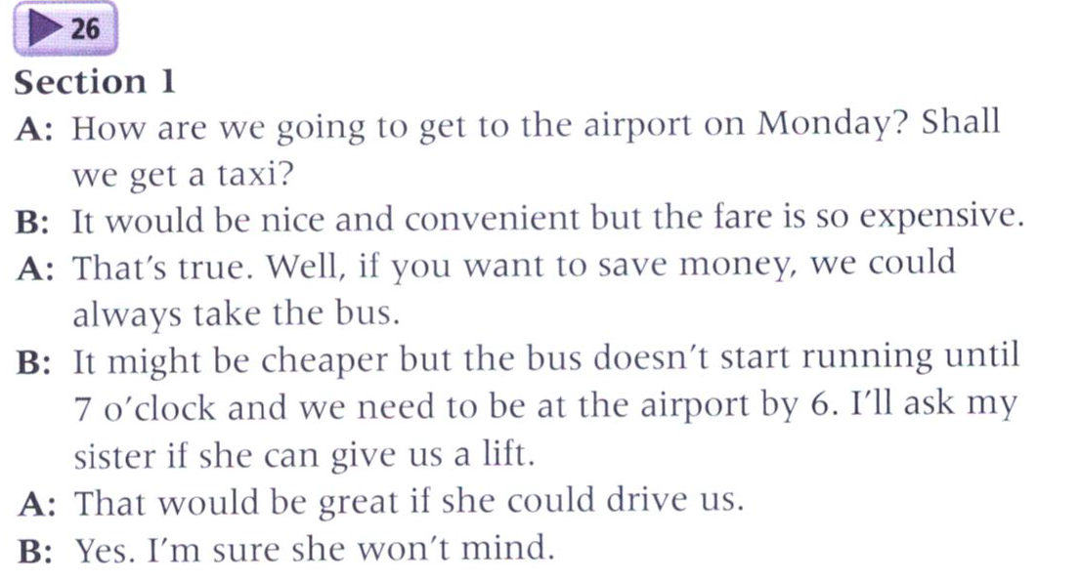
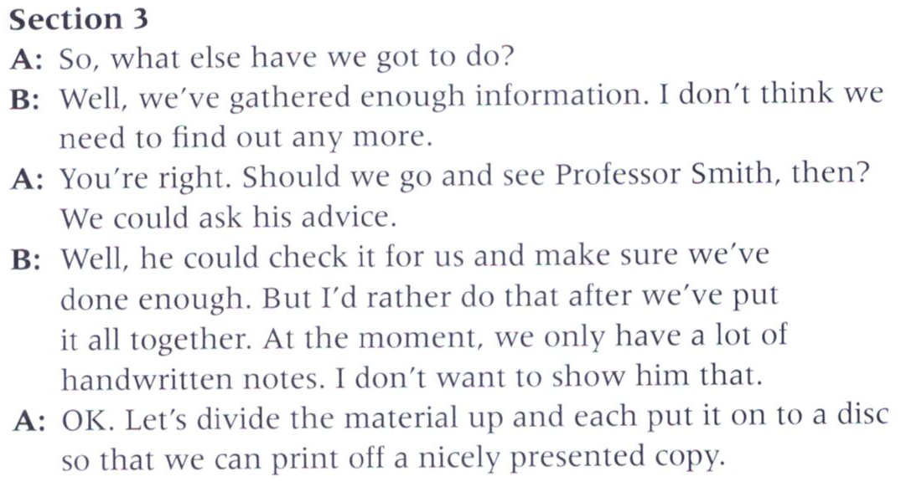
26
Airport, Monday
Taxi, nice, convenient, but expensive
Bus, cheaper, but until 7, airport by 6
A lift from sister
Gather enough, no need to find more
Advice from Smith?
After putting it together, notes, not want to show
Divide up, put on disc, print off

